Slide 1
Lecture 05 – Logic and circuits
2017.08.30
Oh what a tangled web we weave …
Sir Walter Scott

Slide 2
Using Blackboard for assignments
HW 01 due Thursday, Aug. 31 at 11:58p
Type HW 01 text answers into the Word file; insert images of answer diagrams; then upload PDF export to correct place within Blackboard
GTAs will score, typically within 1 week
Lab 01 download assignment Word file from Blackboard; upload PDF with answers prior to start of your lab session
GTA will open PDF for discussion and scoring

Slide 3
Announcements
Today is last day to submit Clicker quiz question answers on paper
Lowest 3 quiz scores will be dropped
All clicker quiz scores to date are entered in Blackboard; review and advise me by email if you have missing scores
Homework 02 (HW02) will post on Friday, due Thursday, Sep. 07
Notes:
If I post HW 02 early then it is possible to mis-upload HW PDF files; want to avoid that problem.

Slide 4
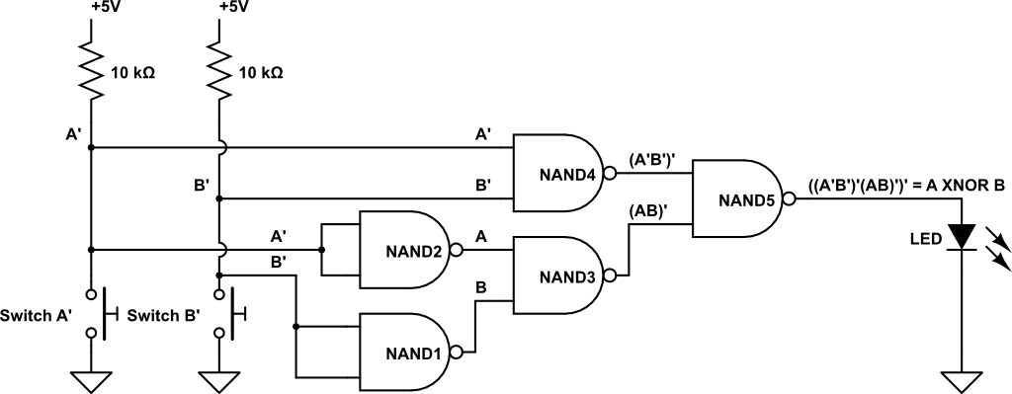
Lab 01 – first circuit
Look for the “words” of the schematic, link those words into the “statement of meaning,” see the grammar of abstraction used in the diagram

Slide 5
Look for the “words” of the schematic
Lab 01 reads – “build a circuit using multiple two-input NAND gates …”
LOGIC GATES

Slide 6
Look for more “words”
Lab 01 reads – “build a circuit using multiple two-input NAND gates to implement … the two-input …”
INPUT

Slide 7
Lab 01 – first circuit
Lab 01 reads – “build a circuit using multiple two-input NAND gates to implement … the two-input … XNOR function.”
OUTPUT

Slide 8
See the grammar of the diagram
Flowing from left to right to enhance readability:
input → logic → output
Now see hardware as software
Data (inputs), algorithm (logic), transformed data (output)

Slide 9
Truth tables
A way to define a Boolean function
Value in consistent table organization
List input variable columns in a useful order, then
Have rightmost column “alternate” at 2⁰ interval, next column left at 2¹ interval, and k^{th} column at 2^{k} interval
A | B | C | ABC (3-input AND)
0 | 0 | 0 | 0
0 | 0 | 1 | 0
0 | 1 | 0 | 0
0 | 1 | 1 | 0
1 | 0 | 0 | 0
1 | 0 | 1 | 0
1 | 1 | 0 | 0
1 | 1 | 1 | 1

Slide 10
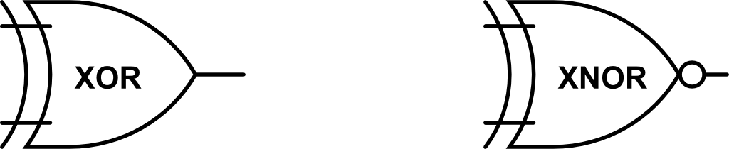
Tables for key 2-input functions
Text has tables for AND, OR, NOT, NAND, NOR
Here are XOR and XNOR
A | B | A⊕B
0 | 0 | 0
0 | 1 | 1
1 | 0 | 1
1 | 1 | 0
A | B | (A⊕B)’
0 | 0 | 1
0 | 1 | 0
1 | 0 | 0
1 | 1 | 1

Slide 11
Seeing other talents in truth tables
A | B | (AB)’
0 | 0 | 1
0 | 1 | 1
1 | 0 | 1
1 | 1 | 0
Look at the truth table for NAND
Do other truth tables lie within?
Look for NOT in NAND
A | A’
0 | 1
1 | 0

Slide 12
Find the NOT gate(s)

Slide 13
Example truth tables
Boolean logic expression is another way to define a function
Relate truth table and logic expression
Sum of Products (SOP) form Boolean expressions
SOP has AND term for each 1; ORs these terms together to form all 1s in the function
A | B | C
0 | 0 | 0 | 1
0 | 0 | 1 | 0
0 | 1 | 0 | 0
0 | 1 | 1 | 1
1 | 0 | 0 | 0
1 | 0 | 1 | 0
1 | 1 | 0 | 1
1 | 1 | 1 | 0
A’B’C’ + A’BC
+ ABC’
A’B’C’
A’BC
ABC’

Slide 14
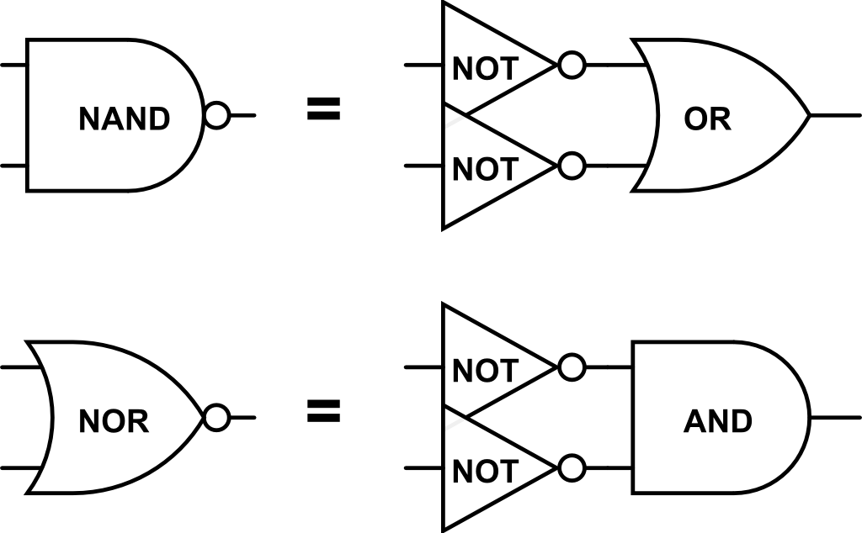
De Morgan’s Laws
(AB)’ = A’ + B’
(A + B)’ = A’B’
A | B | (AB)’ | A’ | B’ | A’ + B’
0 | 0 | 1 | 1 | 1 | 1
0 | 1 | 1 | 1 | 0 | 1
1 | 0 | 1 | 0 | 1 | 1
1 | 1 | 0 | 0 | 0 | 0
A | B | (A + B)’ | A’ | B’ | A’B’
0 | 0 | 1 | 1 | 1 | 1
0 | 1 | 0 | 1 | 0 | 0
1 | 0 | 0 | 0 | 1 | 0
1 | 1 | 0 | 0 | 0 | 0

Slide 15
What are key characteristics of HW?
Two steady voltage levels w/ “gap” between “quality” voltages
Quality of gate output equals or exceeds input, so errors do not accumulate incrementally
Gates react to inputs fast, ~ 10⁻⁹ second
MOSFET transistors are small, billions on a chip
Complementary MOS (CMOS) is LOW POWER, billions of transistors yet chip stays cool
Chips are cheap: HW is affordable

Slide 16
What to know summary
Grammar of the schematic
Logic gates AND, OR, NOT, NAND, NOR, XOR, XNOR
Truth tables within truth tables
Characteristics of HW

Slide 17
Truth tables to Boolean expressions
From a Truth table you can create a Boolean expression
You can represent a Boolean function as
Sum of products: Example z=xy + xy’
or as
Product of sums: Example z=(x+y)(x’+ y’)
POS has an OR term for each 0 in the function; ANDs these terms together to for all 0s in function

Slide 18
Sum of Products (SOP) form
Create Sum of Products form (the OR of AND-terms) from a truth table
AND outputs 1 for a single input value combination, 0 else
If input X = 1 then use X in the AND term, if X = 0 use X’
OR together AND-terms gives Boolean expression that generates every 1 in the output, and every 0 as side effect
X | Y | Z
0 | 0 | 0
0 | 1 | 1
1 | 0 | 1
1 | 1 | 0
Z = X’Y + XY’

Slide 19
Product of Sums (POS) form
Create Product of Sums form (the AND of OR-terms) from a truth table
OR outputs 0 for a single input value combination, 1 else
If input X = 0 then use X in the OR term, if X = 1 use X’
AND together OR-terms gives Boolean expression that generates every 0 in the output, and every 1 as side effect
X | Y | Z
0 | 0 | 0
0 | 1 | 1
1 | 0 | 1
1 | 1 | 0
Z = (X + Y)(X’ + Y’)

Slide 20
Boolean expression reduction
You can simplify Boolean expressions to use fewer gates
Example:
z = a’b’c + a’b’ + ac’ + abc’; 4 ANDs, 1 (big) OR
= a’b’(c+1) + ac’(1+b)
= a’b’+ ac’ ; 2 ANDs, 1 OR
Example:
m = x’yz + x’yz’ + x’y’ + xyz ; 4 ANDs, 1 big OR
= x’y(z+z’) + x’y’ + xyz
= x’y + x’y’ + xyz
= x’(y+y’) + xyz
= x’ + xyz ; 1 AND, 1 OR

Slide 21
Incompletely specified functions
INPUTS____
OUTPUTS____
A | B | C | D | W | X | Y | Z
0 | 0 | 0 | 0 | 0 | 0 | 0 | 1
0 | 0 | 0 | 1 | 0 | 0 | 1 | 0
0 | 0 | 1 | 0 | 0 | 0 | 1 | 1
0 | 0 | 1 | 1 | 0 | 1 | 0 | 0
0 | 1 | 0 | 0 | 0 | 1 | 0 | 1
0 | 1 | 0 | 1 | 0 | 1 | 1 | 0
0 | 1 | 1 | 0 | 0 | 1 | 1 | 1
0 | 1 | 1 | 1 | 1 | 0 | 0 | 0
1 | 0 | 0 | 0 | 1 | 0 | 0 | 1
1 | 0 | 0 | 1 | 0 | 0 | 0 | 0
1 | 0 | 1 | 0 | X | X | X | X
1 | 0 | 1 | 1 | X | X | X | X
1 | 1 | 0 | 0 | X | X | X | X
1 | 1 | 0 | 1 | X | X | X | X
1 | 1 | 1 | 0 | X | X | X | X
1 | 1 | 1 | 1 | X | X | X | X
Table input is all combinations of 4 binary digits (gold columns)
Function is to increment a decimal digit value modulo 10
Binary inputs combinations 1010 through 1111 do not represent a decimal digit, so we Don’t Care how the circuit behaves for these cases, denote with X
If we don’t care how it behaves, then We Can Choose any way we want for how it behaves
Usually choose simple and cheap e.g., replace X in Z by Z = D’

Slide 22
Karnaugh map
Visual technique for simplification of Boolean expressions
Karnaugh map depicts truth tables using algebraic adjacency
Adjacent columns or rows in the map differ by only by one variable
Makes refactoring obvious

Slide 23
Example
Given Sum of Products (SOP) expression R = X’Y’Z+X’YZ’+X’YZ+XYZ’
Create this truth table
Now, create a Karnaugh map and fill the map with the function, R, values
X | Y | Z | R
0 | 0 | 0 | 0
0 | 0 | 1 | 1
0 | 1 | 0 | 1
0 | 1 | 1 | 1
1 | 0 | 0 | 0
1 | 0 | 1 | 0
1 | 1 | 0 | 1
1 | 1 | 1 | 0

Slide 24
Karnaugh map for R
X | Y | Z | R
0 | 0 | 0 | 0
0 | 0 | 1 | 1
0 | 1 | 0 | 1
0 | 1 | 1 | 1
1 | 0 | 0 | 0
1 | 0 | 1 | 0
1 | 1 | 0 | 1
1 | 1 | 1 | 0
XY Z | 00 | 01 | 11 | 10
0 | 0 | 1 | 1 | 0
1 | 1 | 1 | 0 | 0

Slide 25
Karnaugh map for R
X | Y | Z | R
0 | 0 | 0 | 0
0 | 0 | 1 | 1
0 | 1 | 0 | 1
0 | 1 | 1 | 1
1 | 0 | 0 | 0
1 | 0 | 1 | 0
1 | 1 | 0 | 1
1 | 1 | 1 | 0
1
1
XY Z | 00 | 01 | 11 | 10
0 | 0 | 1 | 1 | 0
1 | 1 | 1 | 0 | 0
0
Any 2 left-right or up-down adjacent 1s define 1 input that is both 0 and1, so can omit from the sum of products term
X=0 and X=1 so oval is just YZ’
Y=0 and Y=1 so oval is just X’Z
Z=0 and Z=1 so oval is just X’Y

Slide 26
Karnaugh map adjacency
Any two cells that differ by only 1 input variable are adjacent
Here are some adjacent cell pairs
Note that the left-right and top-bottom edges of this K-map are adjacent
XY Z | 00 | 01 | 11 | 10
0
1

Slide 27
K-map and bigger groupings
Any adjacent group of size 2^{j} is a valid simplification
For this map what groups are possible?
XZ’
XZ
Y’Z’
Y’Z
X
Y’
XY Z | 00 | 01 | 11 | 10
0 | 1 | 0 | 1 | 1
1 | 1 | 0 | 1 | 1
So this truth table, in the form of a K-map, can be written in simplified SOP form (cover all the 1s) as X + Y’

Slide 28
Karnaugh map and Don’t Care
K-map cells fill with X just fine, too
Find biggest cover groups using each X as best helps
This cover does not use X and yields YZ + XY + XZ’
This cover uses X, gives X + YZ a simpler expression and a simpler circuit
XY Z | 00 | 01 | 11 | 10
0 | 0 | 0 | 1 | 1
1 | 0 | 1 | 1 | X

Slide 29
Value from unused gates
Use “left over” gates on a chip to do other operations instead of adding a new chip
Example:
X NAND 1 = X’ ; no need to use an inverter chip when there is a spare NAND gate in a chip

Slide 30
Building with only NAND
Convert SOP to only NAND by inverting twice and simplifying
Example (Lab 01): z = x XOR y = xy'+x'y as SOP form
Negate SOP twice and apply De Morgan’s Law
z = ((xy'+x'y)')' = ((xy')'(x'y)')’ = (x NAND y') NAND (x' NAND y)
Also, since x'= (x x)' = x NAND x and y' = y NAND y then:
z = (x NAND (y NAND y)) NAND ((x NAND x) NAND y)
Compare this expression with the Lab 01 circuit

